Slide 1
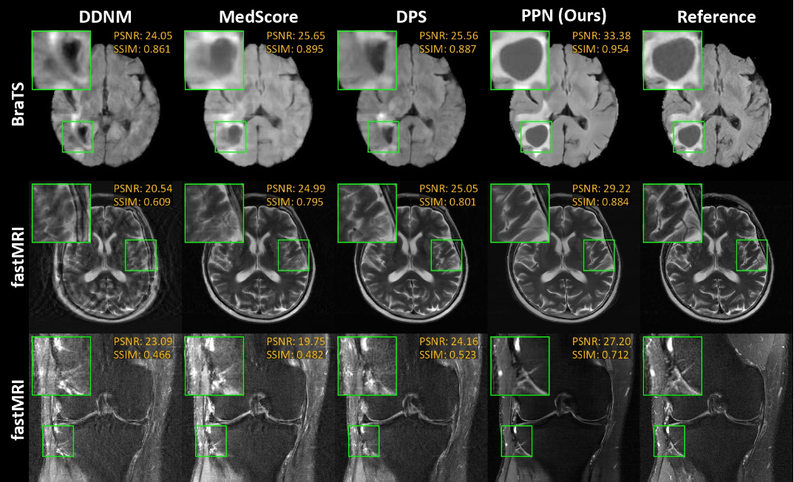
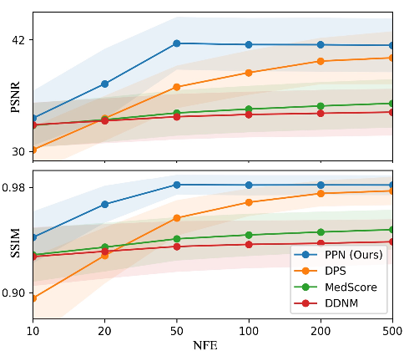
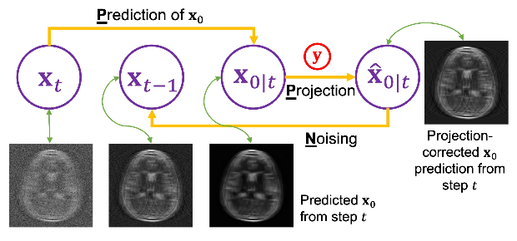
Fast Controllable Diffusion Models for Undersampled MRI Reconstruction
Wei Jiang, Zhuang Xiong, Feng Liu, Nan Ye, Hongfu Sun
The University of Queensland, QLD, AUS
Notes:
Good afternoon, I’m here to give my presentation on my paper.

Slide 2
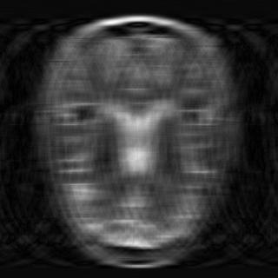
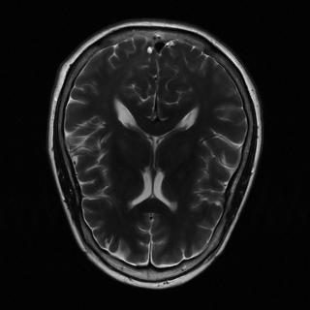
Background
Two Conflicts & Motivation
Artifacts vs. Consistency
Traditional CS methods: Over-smoothed and lacking details
Deep learning (e.g., UNet): Requires paired data for training
MRI Reconstruction
Notes:
Solving inverse problems in Medical Imaging, like reconstructing MRI images, is a hot topic. This is because it can speed up MRI scans. Traditional methods like compressed sensing remove artifacts but often produce overly smooth images due to their simple models.
Recently, deep learning has improved this by learning from paired data. However, the requirement for a large paired dataset is a limitation.

Slide 3
Background
Two Conflicts & Motivation
Artifacts vs. Consistency
Traditional CS methods: Over-smoothed and lacking details
Deep learning (e.g., UNet): Requires paired data for training
Quality vs. Speed
Diffusion models: High-quality but slow
Generating 50k 256x256 images: 1,000 hours!
MRI Reconstruction
Notes:
The diffusion model is a promising type of deep learning model. It demonstrates superior performance in general image tasks and outperforms counterparts like GANs. However, diffusion models for inverse problems face a trade-off between quality and speed. Methods like Repaint and DPS produce high-quality images but are very slow. For example, generating 50k images with a resolution of 256 by 256 on an advanced commercial GPU can take about 1,000 hours, which is much slower than GANs.

Slide 4
Background
Two Conflicts & Motivation
Artifacts vs. Consistency
Traditional CS methods: Over-smoothed and lacking details
Deep learning (e.g., UNet): Requires paired data for training
Quality vs. Speed
Diffusion models: High-quality but slow
Generating 50k 256x256 images: 1,000 hours!
Motivation
Can we improve speed while maintaining quality?
MRI Reconstruction
Notes:
So, can we speed up the process without losing quality? This is the focus of our study.

Slide 5

Background
MRI Inverse Problem
Reconstruct $x$ from $y$ using a model
$y=Ax+ε$ where $A=MF$
Notes:
The MRI inverse problem is formulated as reconstructing the unknown x from observations y using a traditional model.

Slide 6
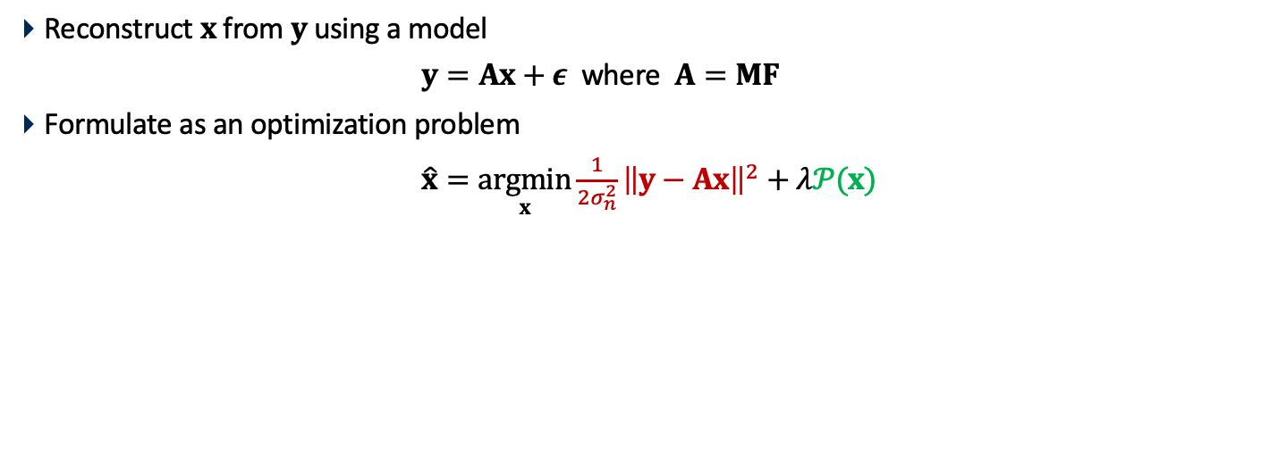
Background
MRI Inverse Problem
Reconstruct $x$ from $y$ using a model
$y=Ax+ε$ where $A=MF$
Formulate as an optimization problem
$\hat{x}=\underset{x}{argmin}{\frac{1}{2σ_{n}^{2}}{\left\|y−Ax\right\|}^{2}+λ𝒫(x)}$
Notes:
This inverse problem is framed as an optimization problem, where the red part represents the fidelity term, ensuring consistency, and the green part represents the prior, providing detailed results.

Slide 7
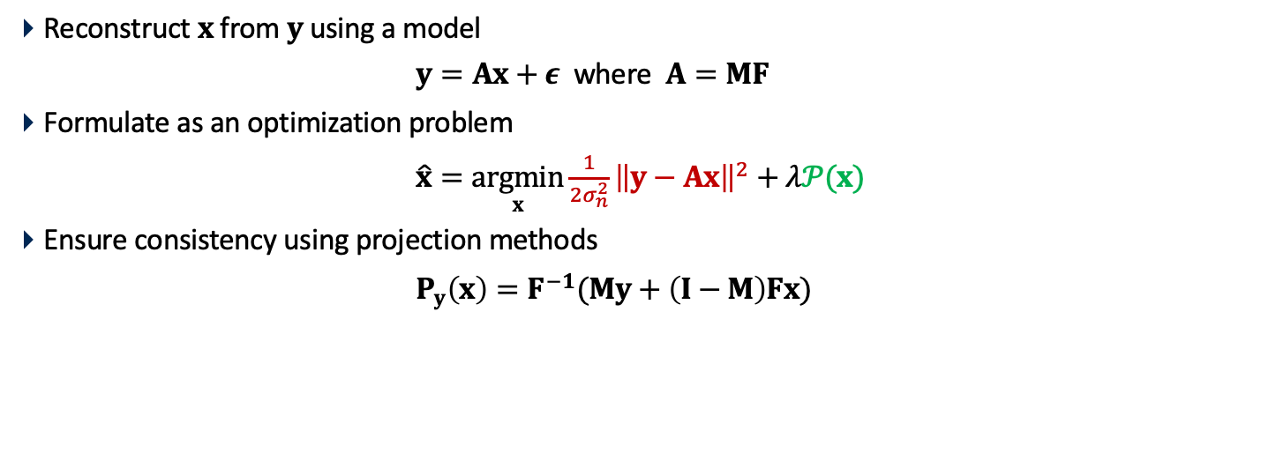
Background
MRI Inverse Problem
Reconstruct $x$ from $y$ using a model
$y=Ax+ε$ where $A=MF$
Formulate as an optimization problem
$\hat{x}=\underset{x}{argmin}{\frac{1}{2σ_{n}^{2}}{\left\|y−Ax\right\|}^{2}+λ𝒫(x)}$
Ensure consistency using projection methods
$P_{y}\left(x\right)=F^{−1}(My+\left(I−M\right)Fx)$
Notes:
We use a projection method to ensure data consistency.

Slide 8
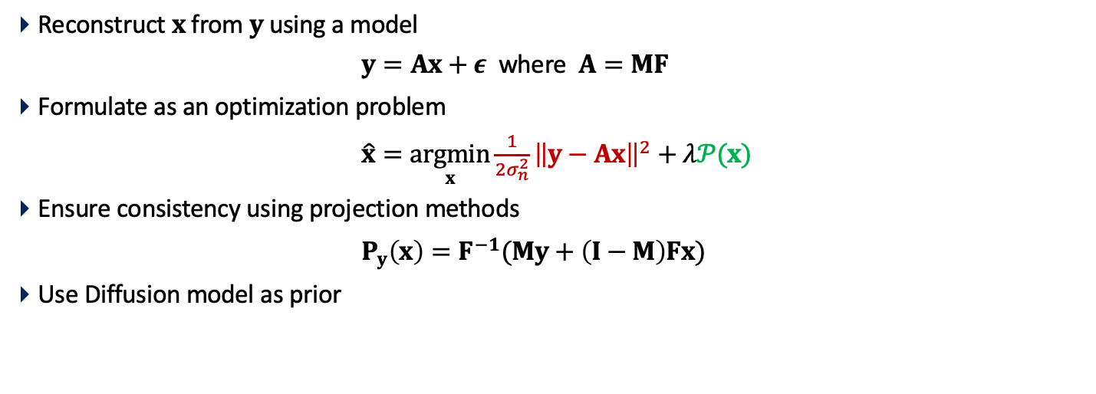
Background
MRI Inverse Problem
Reconstruct $x$ from $y$ using a model
$y=Ax+ε$ where $A=MF$
Formulate as an optimization problem
$\hat{x}=\underset{x}{argmin}{\frac{1}{2σ_{n}^{2}}{\left\|y−Ax\right\|}^{2}+λ𝒫(x)}$
Ensure consistency using projection methods
$P_{y}\left(x\right)=F^{−1}(My+\left(I−M\right)Fx)$
Use Diffusion model as prior
Notes:
and employ Diffusion models as a prior.

Slide 9

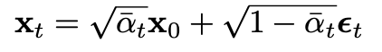
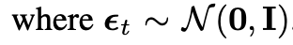

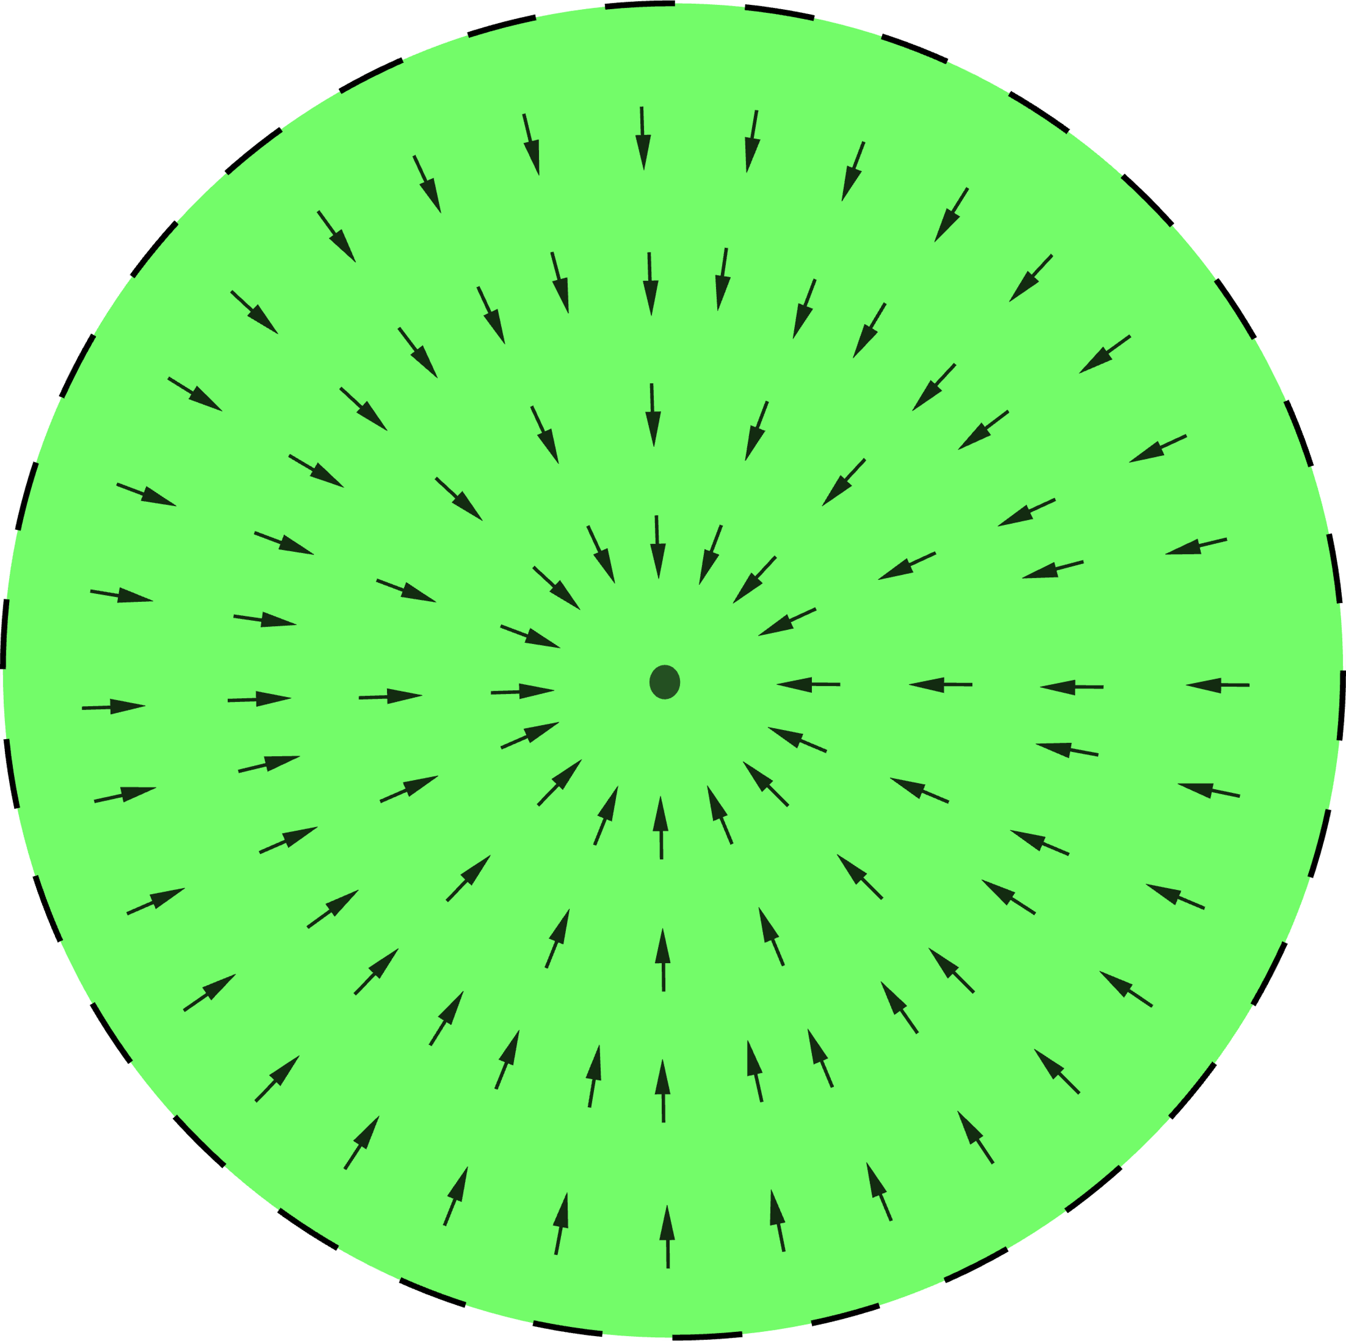
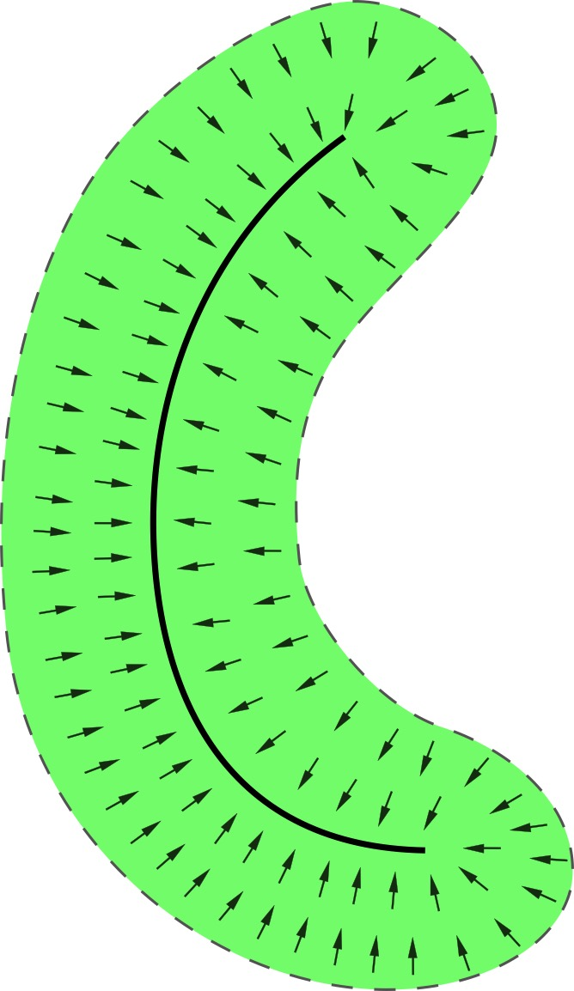
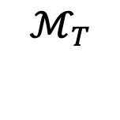
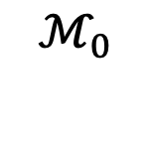
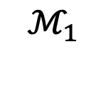
Background
Diffusion Models
Diffusion process
Signal is reducing
$$ℳ_{T}$$
$$ℳ_{1}$$
$$ℳ_{0}$$
Notes:
Let’s review diffusion models. A diffusion model consists of two processes. The first, diffusion process, start from data x_0, noisy samples can be directly generated using the formula. Here, alpha_t is related to the hyperparameters and shrinks over time. [click] This process also illustrate in the picture. On the right, we have the data manifold, M0. It gradually adds noise to form different noisy level manifolds, eventually reaching MT, a Gaussian distribution.

Slide 10
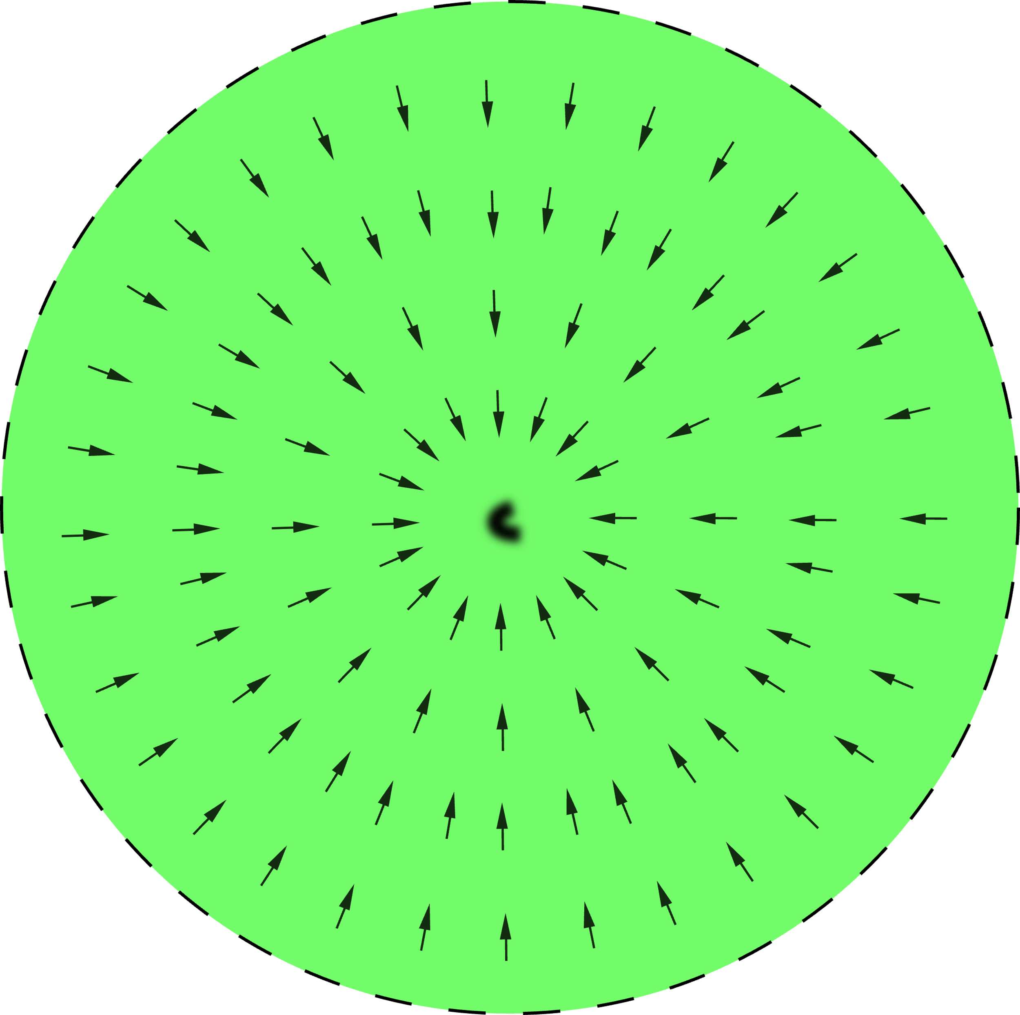
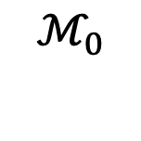
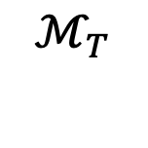
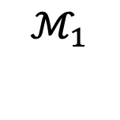
Background
Diffusion Models
Estimated by model
Denoising process
$$ℳ_{T}$$
$$ℳ_{1}$$
$$ℳ_{0}$$
Notes:
The second is called the denoising process. We can sample images using this formula, [click] where the first error epsilon_theta given x_t is estimated by the diffusion model. [click] The estimated error is equivalent to the score, represented as vector fields in the pictures. The denoising starts from a sample from the Gaussian distribution MT, following the score and finally reaching a clean image on the data manifold M0.

Slide 11
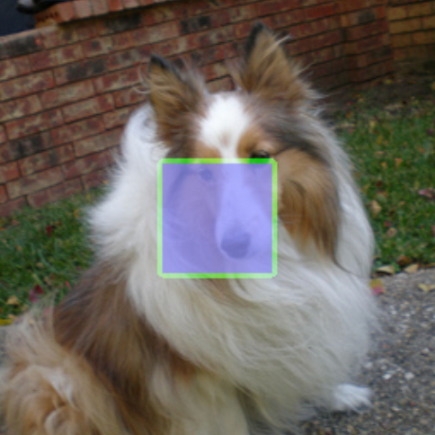
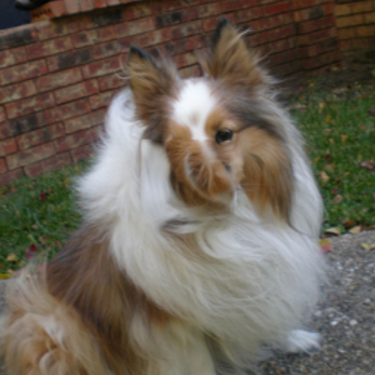
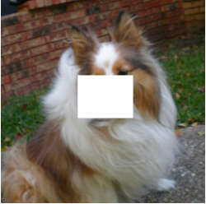
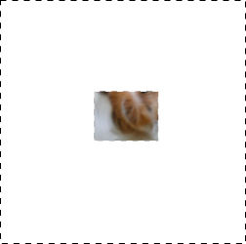
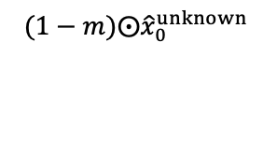
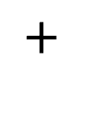
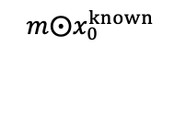
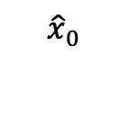
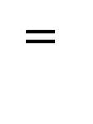
The Success of Repaint
The Inpainting Example
Out of manifold
disharmonious
input
$${\hat{x}}_{0}$$
$$m⨀x_{0}^{known}$$
$$(1−m)⨀{\hat{x}}_{0}^{unknown}$$
$$=$$
$$+$$
Notes:
Let's use an example to illustrate why repaint success. This is a typical inpainting example. the blue box in the input image represents the missing part, and we want to guess its content. [click] The method in Repaint naively combines the known part of the image with content sampled by a diffusion model.
Here, the missing part generated by the diffusion model is purely hair, which mismatches with the nose part of the dog. This occurs because the sampling process does not consider the known part, leading to two disharmonious components. As a result, the combined image is strange, and will not close to any data. In other words, it falls outside the data manifold.

Slide 12
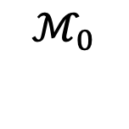
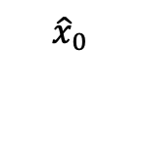
The Success of Repaint
Manifold Explanation
In manifold
input
Out of manifold
$${\hat{x}}_{0}$$
$$ℳ_{0}$$
Notes:
We use a single curve to represent the data manifold, called M0. Since the input is similar to the training data, it will be on the data manifold, labeled as a blue star. Conversely, the disharmonious image will be outside of the manifold, labeled as a red star.

Slide 13
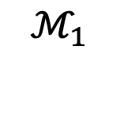
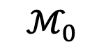
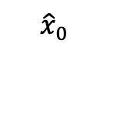
The Success of Repaint
Manifold Explanation
input
$${\hat{x}}_{0}$$
$$ℳ_{1}$$
$$ℳ_{0}$$
Notes:
After adding noise, we get two points in the left noisy manifold M1

Slide 14
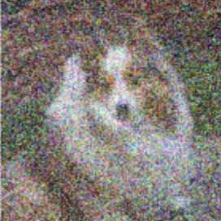
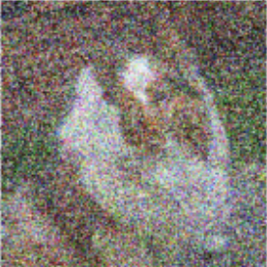
The Success of Repaint
Manifold Explanation
input
$${\hat{x}}_{0}$$
$$ℳ_{1}$$
$$ℳ_{0}$$
Notes:
The animation in the noisy manifold illustrates the process of adding noise.

Slide 15
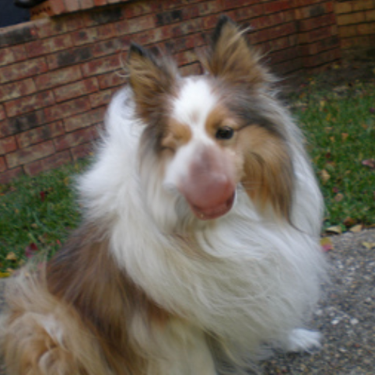
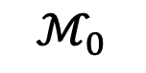
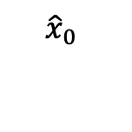
The Success of Repaint
Manifold Explanation
input
$${\hat{x}}_{0}$$
$$ℳ_{1}$$
$$ℳ_{0}$$
big noise
Notes:
The denoising process involves moving the points according to the score (the vector field). After denoising, the red star is close to the blue one. Meanwhile, it generates noise to replace the hair. But, it seems the nose is too big for this dog. So, let's continue to fix this!

Slide 16
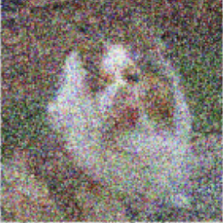
The Success of Repaint
Manifold Explanation
input
$${\hat{x}}_{0}$$
$$ℳ_{1}$$
$$ℳ_{0}$$
Notes:
Add noise to the images.

Slide 17
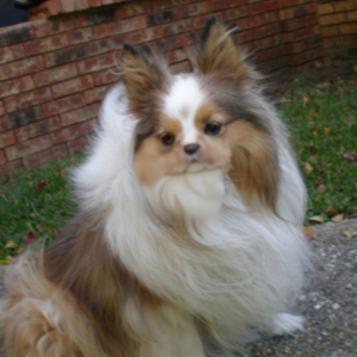
The Success of Repaint
Manifold Explanation
input
$${\hat{x}}_{0}$$
$$ℳ_{1}$$
$$ℳ_{0}$$
small dog
with large body
Notes:
denoising again, the red star moves closer to the blue one. The dog's face appears correct and looks like a Chihuahua, a small dog, but with a big body. We still need to fix this.

Slide 18
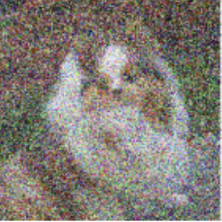
The Success of Repaint
Manifold Explanation
input
$${\hat{x}}_{0}$$
$$ℳ_{1}$$
$$ℳ_{0}$$
Notes:
Add noise.

Slide 19
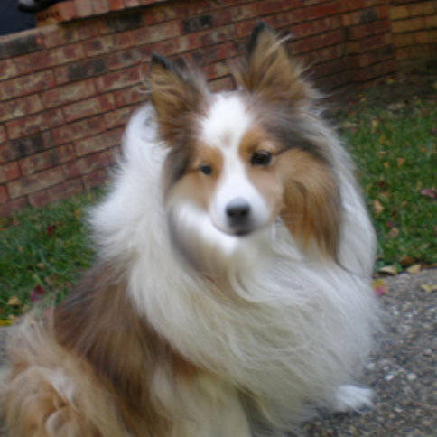
The Success of Repaint
Manifold Explanation
Resampling is the key!
input
$${\hat{x}}_{0}$$
$$ℳ_{1}$$
$$ℳ_{0}$$
correct dog!
Notes:
And finally, we obtain a point close to the blue one. The generated dog appears natural, with the face matching the body. The key to the success of repaint is using resampling to fully utilize the score provided by the diffusion model.
This is just the repaint method applied to one pair of adjacent manifolds. In a real application, we need multiple iterations between manifolds to solve the inverse problem.

Slide 20
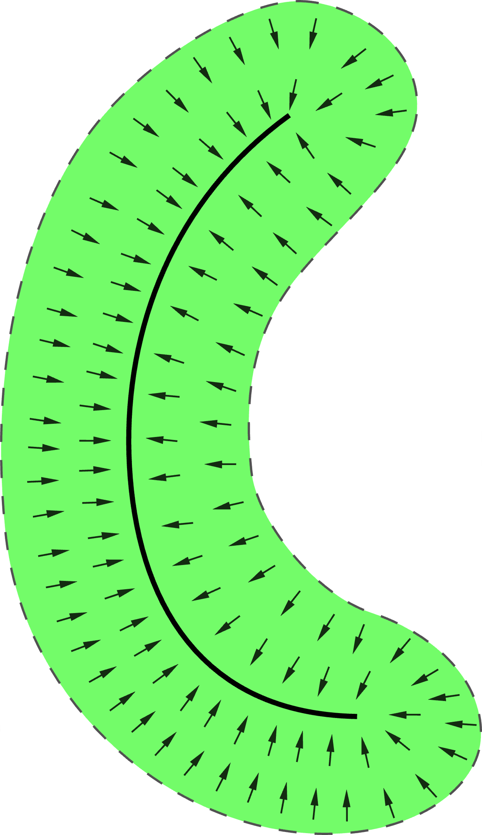
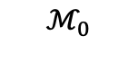
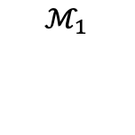
The Success of Repaint
Simplifying Resampling
Simplify
1
0
$$ℳ_{1}$$
$$ℳ_{0}$$
Notes:
Let's simplify resampling. Let manifolds be points on an axis, as shown in the picture on the right.

Slide 21
The Success of Repaint
Simplifying Resampling
Simplify
1
0
$$ℳ_{1}$$
$$ℳ_{0}$$
Notes:
Denoising

Slide 22
The Success of Repaint
Simplifying Resampling
Simplify
1
0
Notes:
Diffusion

Slide 23
The Success of Repaint
Simplifying Resampling
Simplify
1
0
Notes:
denoising again. Now we have the tool to illustrate the full algorithm of repaint and its adaptations.

Slide 24
Method
The Born of Our Method
Repaint
Stride = 1
Notes:
The repaint method starts from Gaussian noise, labeled as T on the axis. It resamples several times between adjacent manifolds before moving to the next. Repaint provides two hyperparameters: the jump length (also called stride) and the resampling number, to balance speed and quality. In this situation, the stride is 1.

Slide 25
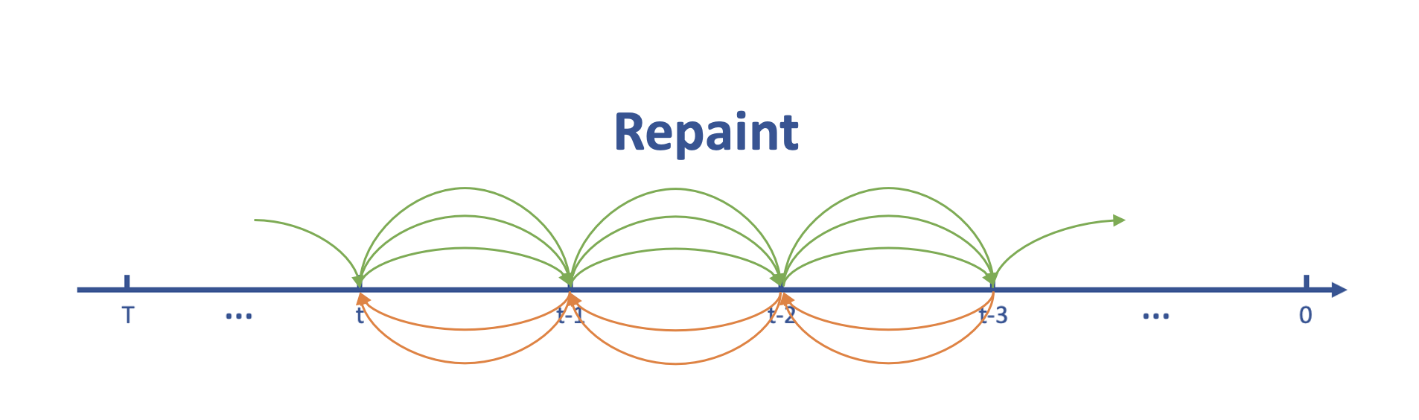

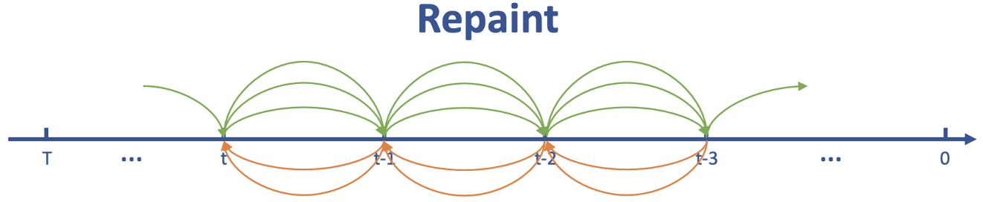
Method
The Born of Our Method
Adaptation 1
Stride = 2
Notes:
Here, we use stride 2 to speed up. [wait for animation to be finisthed]

Slide 26
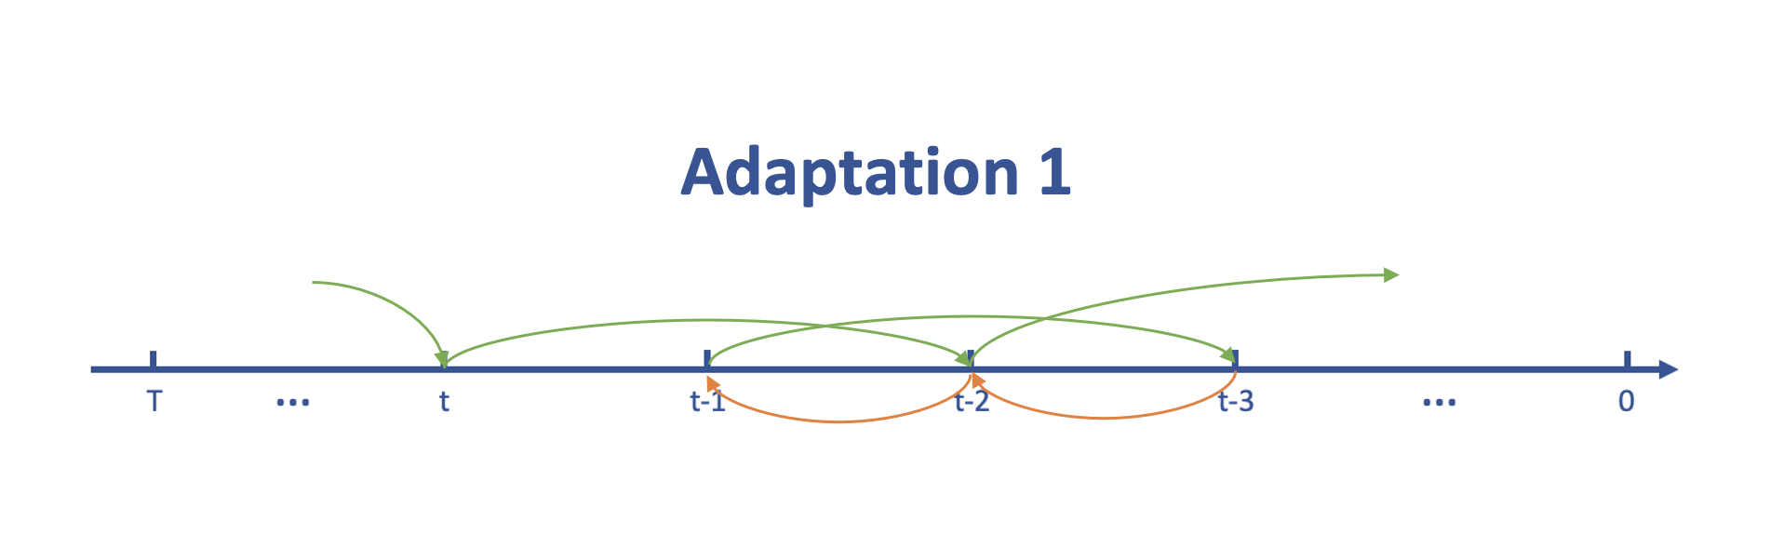
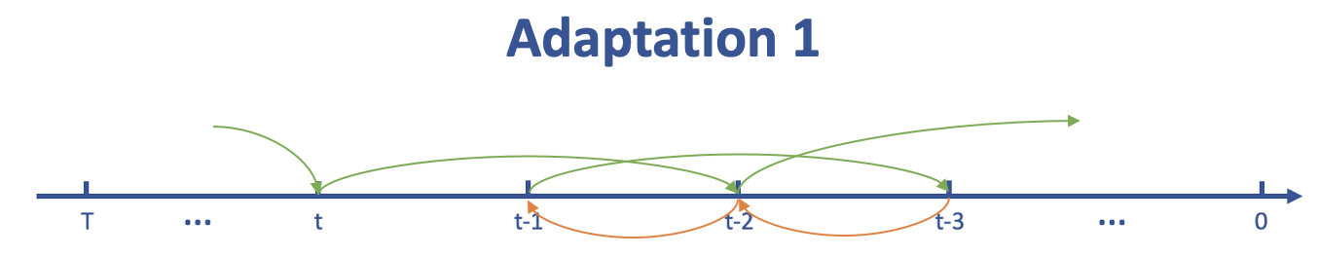
Method
The Born of Our Method
Adaptation 2
Stride = 3
Notes:
stride 3.

Slide 27
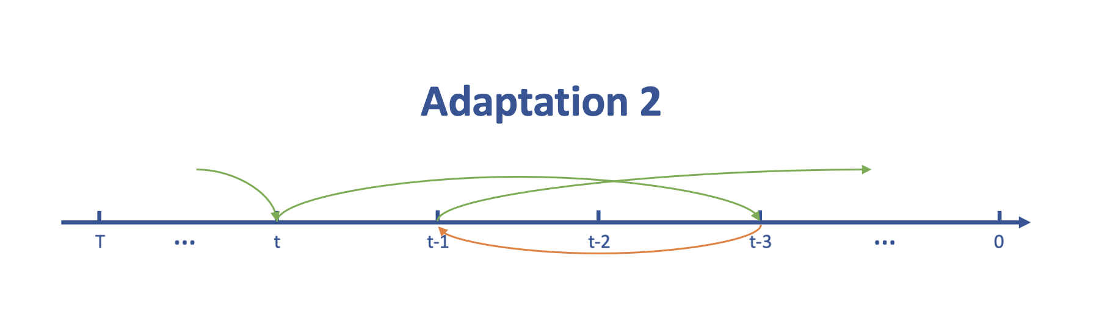

Method
The Born of Our Method
Adaptation 3
Max Stride
Notes:
What about the maximun stride?

Slide 28


Method
The Born of Our Method
Adaptation 4
Start from 50
50
49
48
47
Max Stride, Start from 50
This is our method: PPN!
Notes:
According to our ablation study, this adaptation 4 achieved the best balance between performance and sampling speed in MRI reconstruction. This algorithm starts with 50 steps and uses the maximum stride for resampling. We use this adaptation as our method and we call it: PPN.

Slide 29


Method
The Born of Our Method
Notes:
In MRI reconstruction problems, from repaint to adaptation 3, the performance improves as the stride becomes larger. Additionally, we find that 1000 steps are not necessary, as shown in adaptation 4. Starting from the last 50 steps and using the maximum stride gives us the best results.

Slide 30










Method
The Mathematical Expression
PPN
Notes:
Let’s examine the mathematical expression of a single step.

Slide 31
Method
The Mathematical Expression
PPN
Providing Detail
Notes:
The first step is to predict x_0 given x_t, using prior Diffusion model to provide image detail.

Slide 32
Method
The Mathematical Expression
PPN
Ensuring Consistency
Notes:
The next step is to perform the projection, ensuring consistency with measurement y in k-space. The projection requires converting the image back and forth between k-space and image space. However, this process will result in a disharmonious image.

Slide 33
Method
The Mathematical Expression
PPN
Preparing for the Next Resampling
Notes:
In the final part of a single iteration step, we add noise to this disharmonious image. We then utilize the score information provided by the diffusion model to continue the next resampling.

Slide 34

Method
The Mathematical Expression
PPN
Single step
Repeat S=50 times
Notes:
This is the entire algorithm. The red box contains the single step we just discussed. This single step is resampled 50 times across different noise levels and data manifolds.

Slide 35
Experiment
The Design
What Types of Experiments?
Undersampled MRI reconstruction
Using uniform 1D Cartesian masks: 4x, 8x, 12x
Notes:
Let's look at the experiments. We designed them from four perspectives. First, what types of experiments should we focus on? The undersampled MRI reconstruction. We conducted experiments using datasets generated by uniform 1D Cartesian masks with three different undersampling rates.

Slide 36
Experiment
The Design
What Types of Experiments?
Undersampled MRI reconstruction
Using uniform 1D Cartesian masks: 4x, 8x, 12x
Does PPN Generalize Well to Different Datasets?
Tested on BraTS, FastMRI Brain and FastMRI Knee
Notes:
The next question is whether PPN’s performance generalizes well to different datasets. To test this, we evaluated PPN on three datasets: BraTS, FastMRI Brain, and FastMRI Knee.

Slide 37
Experiment
The Design
What Types of Experiments?
Undersampled MRI reconstruction
Using uniform 1D Cartesian masks: 4x, 8x, 12x
Does PPN Generalize Well to Different Datasets?
Tested on BraTS, FastMRI Brain and FastMRI Knee
What Are the Baselines, and Are They Fair Comparations?
Compared with DPS, DDNM, and DPS
Using the same pretrained model
Notes:
Third, what are the baselines, and are they fair comparisons? We use three baselines: DPS, DDNM, and DPS. They are different algorithms based on the same pretrained diffusion models, making this a fair comparison.

Slide 38
Experiment
The Design
What Types of Experiments?
Undersampled MRI reconstruction
Using uniform 1D Cartesian masks: 4x, 8x, 12x
Does PPN Generalize Well to Different Datasets?
Tested on BraTS, FastMRI Brain and FastMRI Knee
What Are the Baselines, and Are They Fair Comparations?
Compared with DPS, DDNM, and DPS
Using the same pretrained model
How Well Does PPN Perform?
Quickly reaches the best SSIM/PSNR using 50 steps
Better than the baseline methods
Notes:
The last question is how well PPN performs. Experiments show that our PPN outperforms the baseline methods in almost all experiments using only 50 steps. Let’s examine this now.

Slide 39

Experiment
Results
Notes:
This image shows the results of PPN compared to the baseline methods on three datasets. It is clear that our proposed PPN method achieves the best performance. For example, in the first row with the BraTS dataset test set, our method can reconstruct the lesion very precisely.

Slide 40


Experiment
Results
Notes:
In 2nd Experiment, we test the speed of our proposed method compared to the baselines using the BraTS dataset. We can see that our PPN (the blue line) quickly reaches the best performance in just 50 steps and then levels out. At this 50-step, our method clearly outperforms the other baseline methods by a large margin.

Slide 41

Experiment
Results
Notes:
Let’s check different undersampled accelerations. Our proposed method performs best in most experiments, especially at 4x and 8x acceleration in MRI. Notably, in terms of SSIM, our method not only performs better on average but also has the smallest standard deviation, indicating more stable quality.

Slide 42

Experiment
Results
Notes:
We also perform the SSIM comparison on the fastMRI knee and brain datasets with 8x acceleration. Again, our method is the best.

Slide 43
Conclusion
PPN based on Diffusion models for MRI
Efficient: Approximately 20 times faster
High Quality: Achieved the best performance at 50 NFEs
Generalizes well: BraTS, FastMRI brain and knee.
Future work: Distribution shift tasks & in-vivo scenarios
Notes:
In conclusion, we proposed a fast method called PPN for MRI reconstruction based on a diffusion model. Our method achieved competitive performance with a faster version of resampling. It uses fewer sampling steps, achieving approximately 20x speedup and the best performance at 50 steps compared to the baseline. It also generalizes well across MRI datasets like BraTS, fastMRI Brain, and fastMRI Knee.
One limitation is its failure with noisy or multi-coil observations due to hard projection steps. Future work will focus on improving the projection to handle distribution shifts and in-vivo scenarios using the same PPN framework.

Slide 44
Thank You for Your Attention!

